Slide 1

EXCEL

Slide 2
Q1 : Cleaning the data (Remove Duplicates & Fill Null values)
Inference :
Data contained null values in the comment column.
The null values were replaced by the previous cell value.
Data contained no duplicate values.
comment
"Engaging and informative presentation!"
"Engaging and informative presentation!"
"Engaging and informative presentation!"
"Engaging and informative presentation!"
"Engaging and informative presentation!"
"Engaging and informative presentation!"
"Engaging and informative presentation!"
"Engaging and informative presentation!"
"Engaging and informative presentation!"
"Engaging and informative presentation!"
"Engaging and informative presentation!"
"Engaging and informative presentation!"
"Engaging and informative presentation!"
"Engaging and informative presentation!"
"Engaging and informative presentation!"
"Engaging and informative presentation!"
"Engaging and informative presentation!"
Steps :
Remove Duplicates
Select the data.
Data->Remove Duplicates.
Fill Null Values
Check for null values.
Ctrl+G->Specials->Blanks.
Enter =PreviousCellValue
Ctrl+Enter.

Slide 3
Q2 : Relationship between Trending and Publish date to understand time for a video to go trending.
Inference :
For a video to go trending it takes an average of 2.3 days from the publish date.
publish_date | trending_date | time_diff
05-03-2018 | 06-03-2018 | 1
05-12-2017 | 09-12-2017 | 4
11-05-2018 | 13-05-2018 | 2
26-05-2018 | 29-05-2018 | 3
13-12-2017 | 16-12-2017 | 3
12-05-2018 | 13-05-2018 | 1
10-04-2018 | 16-04-2018 | 6
01-03-2018 | 02-03-2018 | 1
22-01-2018 | 24-01-2018 | 2
12-03-2018 | 15-03-2018 | 3
Average of time_diff
2.3
Steps :
Copy the Publish Date & Trending Date column to a new sheet.
Create a column time_diff and calculate the time difference between the two dates.
Create a pivot table and find the average of the time_diff column
Formula :
time_diff = trending_date -publish_date
=ROUND(avg_time_diff)

Slide 4
Q3 : Average Views and Engagement Rate based on category
Inference :
Movies Category has the highest Avg Views.
Pets & Animals has the highest engagement rate.
Category | Average of views | Sum of views | Sum of comment_count | Sum of likes | Engagement_rate
Movies | 3862K | 7724K | 5K | 80K | 1%
Gaming | 3436K | 68728K | 179K | 1988K | 3%
Pets & Animals | 2491K | 2491K | 21K | 186K | 8%
Music | 2018K | 2447689K | 3451K | 54100K | 2%
Film & Animation | 1801K | 941674K | 1196K | 14309K | 2%
Sports | 1379K | 478636K | 786K | 9390K | 2%
Howto & Style | 827K | 395218K | 412K | 4323K | 1%
Comedy | 717K | 798799K | 3117K | 38804K | 5%
Science & Technology | 665K | 199387K | 3382K | 9567K | 6%
Shows | 649K | 78556K | 64K | 427K | 1%
Entertainment | 575K | 4337761K | 8970K | 83836K | 2%
People & Blogs | 450K | 554922K | 1032K | 8841K | 2%
Autos & Vehicles | 333K | 11331K | 27K | 189K | 2%
News & Politics | 297K | 744883K | 1056K | 5763K | 1%
Travel & Events | 193K | 772K | 2K | 13K | 2%
Education | 93K | 73817K | 456K | 3529K | 5%
Religious | 57K | 3929K | 7K | 128K | 3%
Steps :
Find Category Name from Category Sheet using Vlookup.
Using Pivot Table compute Avg Views, Sum of views, sum of comment count, and sum of likes.
Compute Engagement rate using the given formula.
Formula :
Engagement rate = (E4+D4)/C4.
To find category using Id
VLOOKUP(E2,Category!$A$1:$B$33,2,0)

Slide 5
Q4 : Category name using category ID(Xlookup)
Inference :
Using Xlookup we can look through the values we want from an array of elements
channel_title | category_id | Category
Punjabi Live Tv | 25 | News & Politics
ZEE 24 TAAS | 25 | News & Politics
Kangra Boys | 23 | Comedy
Kangra Boys | 23 | Comedy
The Quint | 17 | Sports
Steps :
Create a column Category
Using Xlookup find for the category name corresponding to category id.
Formula :
XLOOKUP(B3,'YouTube data'!E:E,'YouTube data'!P:P,"Error")

Slide 6
Q5 :
Inference :
Steps :
Formula :

Slide 7
Q6 : Average of comment based on comment disabled or not
Inference :
When comments are enabled there and more comment and when the comments are disabled we cannot comment so average of comment count is 0 when comments are disabled
Comments Disables | Average of comment_count
FALSE | 1537.62
TRUE | 0
Steps :
Create a pivot table
Calculate average comments based on comments disabled or not.
Formula :
Used pivot table

Slide 8
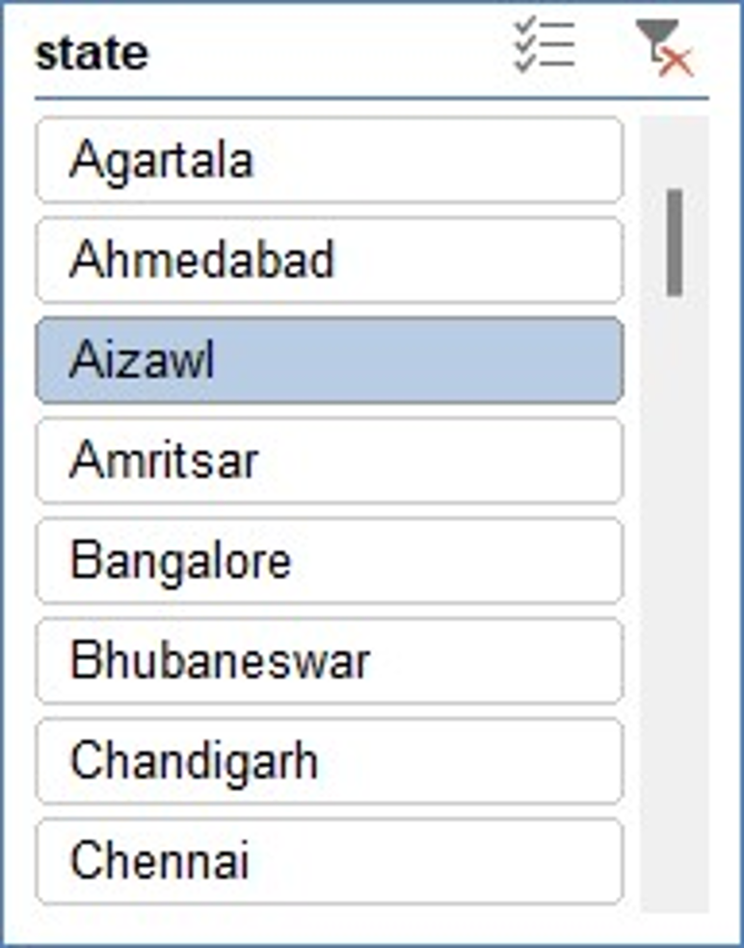
Q7 : Category wise Average likes, Views & Comments
Inference :
Entertainment Category has the highest average of views, likes and comments compared to all category
Row Labels | Sum of likes | Sum of views | Sum of comment_count
Comedy | 513K | 14402K | 34K
Education | 63K | 1720K | 10K
Entertainment | 1409K | 71133K | 155K
Film & Animation | 203K | 10141K | 14K
Howto & Style | 142K | 9826K | 8K
Music | 424K | 22744K | 27K
News & Politics | 104K | 11357K | 23K
People & Blogs | 234K | 11195K | 34K
Religious | 4K | 123K | 0K
Science & Technology | 194K | 5098K | 27K
Shows | 12K | 2293K | 2K
Sports | 38K | 3617K | 6K
Steps :
Create a Pivot Table
Based on category calculate avg of views, likes & comments

Slide 9
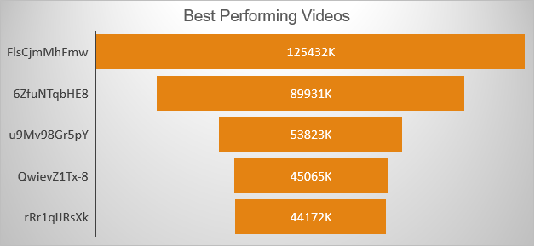
Q8 : Highest Views and Engagement rate
Inference :
Video Id – FlsCjmMhFmw
This video has the highest view and Engagement Rate
video_id | Sum of views | Sum of engagement
FlsCjmMhFmw | 125432K | 2.97%
6ZfuNTqbHE8 | 89931K | 3.29%
u9Mv98Gr5pY | 53823K | 2.58%
QwievZ1Tx-8 | 45065K | 3.73%
rRr1qiJRsXk | 44172K | 1.88%
Steps :
Calculate Engagement Rate
Find Video Highest Views and Engagement Rate
Formula :
Engagement Rate = (likes+comment)/views

Slide 10
Q9 : Analysis of Views and comments based on publish dates
Inference :
First Quarter of the year performs well compared to all other quarters
Row Labels | Sum of views | Sum of comment_count
Qtr1 | 4729780K | 9123K
Qtr2 | 3716188K | 8618K
Qtr4 | 2700350K | 6422K

Slide 11
Q10 : Percentage increase in next year
Inference :
Likes has increased by 33%
Comments has increased by 36%
Views has increased by 32%
Row Labels | Sum of likes | likes % | Sum of comment_count | comment % | Sum of views | views %
2017 | 59063929 | 33% | 6422378 | 36% | 2700407997 | 32%
2018 | 176409897 |  | 17741295 |  | 8445909227
Formula :
% increase = (previous year / present year)*100

Slide 12
Q11 :
Inference :
Steps :
Formula :

Slide 13
Q12 :
Inference :
Steps :
Formula :

Slide 14
Q13 : Category Wise Comment Count
Inference :
Entertainment category has highest comment count
Category | Sum of comment_count
Entertainment | 8970K
Music | 3451K
Science & Technology | 3382K
Comedy | 3117K
Film & Animation | 1196K
News & Politics | 1056K
People & Blogs | 1032K
Sports | 786K
Education | 456K
Howto & Style | 412K
Gaming | 179K
Shows | 64K
Autos & Vehicles | 27K
Pets & Animals | 21K
Religious | 7K
Movies | 5K
Travel & Events | 2K
Steps :
Create a pivot & calculate category wise sum of comment count

Slide 15
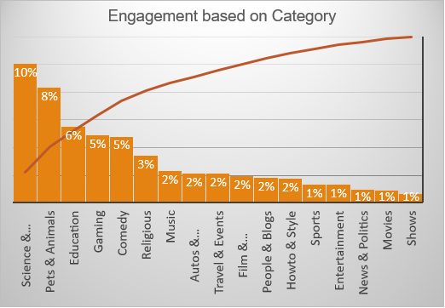
Q14 : Category wise Engagement rate
Inference :
* Science and Technology has the highest Engagement rates compared to other category
Category | Average of engagement
Science & Technology | 10%
Pets & Animals | 8%
Education | 6%
Gaming | 5%
Comedy | 5%
Religious | 3%
Music | 2%
Autos & Vehicles | 2%
Travel & Events | 2%
Film & Animation | 2%
People & Blogs | 2%
Howto & Style | 2%
Sports | 1%
Entertainment | 1%
News & Politics | 1%
Movies | 1%
Shows | 1%
Steps :
Create a pivot and compute category wise engagement rate and visualize it

Slide 16
Q15 : Correlation between likes, dislikes and comments
Inference :
When likes & dislikes increases , comment count also increases
Formula :
CORREL(A1:A16308,C1:C16308)
likes&comment | dislikes&comment
0.76 | 0.70

Slide 17
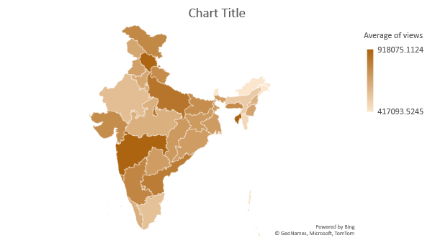
Q16 : Geographical wise Avg Views
Inference :
Tripura has highest Avg Views based on geographical location .
Row Labels | Average of views
Tripura | 918075.1
Maharashtra | 910266.1
Himachal Pradesh | 907667
Uttar Pradesh | 846194.6
Andhra Pradesh | 816488.1
Goa | 816428
Steps :
Create a pivot table and compute country wise average views
Plot the data in a map .

Slide 18
Q17 :
Inference :
Steps :
Formula :

Slide 19
Q18 :
Inference :
Steps :
Formula :

Slide 20
Q19 :
Inference :
Steps :
Formula :

Slide 21
Q20 :
Inference :
Steps :
Formula :

